Slide 1
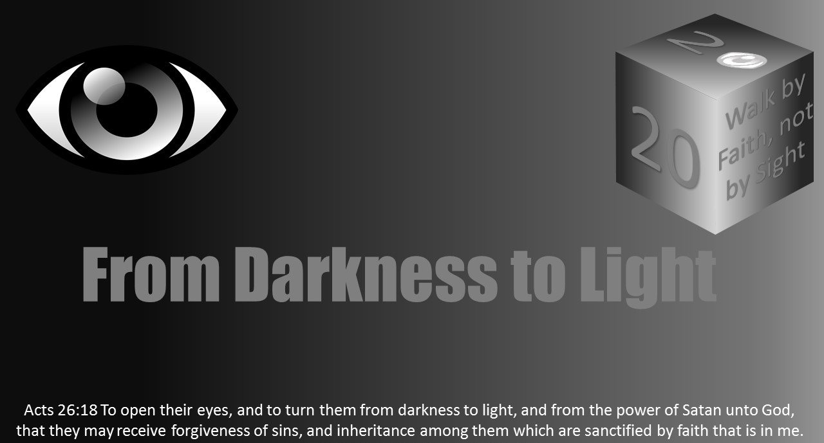


Slide 2
Light Lesson 23 His Eye Is on the Sparrow

Slide 3
Introduction
In Matthew 10, Jesus sent out His twelve apostles and “gave them power over unclean spirits, to cast them out, and to heal all kinds of sickness and all kinds of disease” (Matt 10:1).
This commission was limited in that they were not allowed to “go into the way of the Gentiles” or “enter a city of the Samaritans” (Matt 10:5). Instead, they were sent “to the lost sheep of the house of Israel” (Matt 10:6).
Persecution would accompany their preaching (Matt 10:16–22). The opposition of the Pharisees would be like ravaging wolves.
The disciples’ only hope would be to look to their Shepherd for protection. As an encouragement amidst this persecution, Jesus told them of His Father’s care for the righteous.
"And do not fear those who kill the body but cannot kill the soul. But rather fear Him who is able to destroy both soul and body in hell. Are not two sparrows sold for a copper coin? And not one of them falls to the ground apart from your Father's will. But the very hairs of your head are all numbered. Do not fear therefore; you are of more value than many sparrows." (Matt 10:27–31).

Slide 4
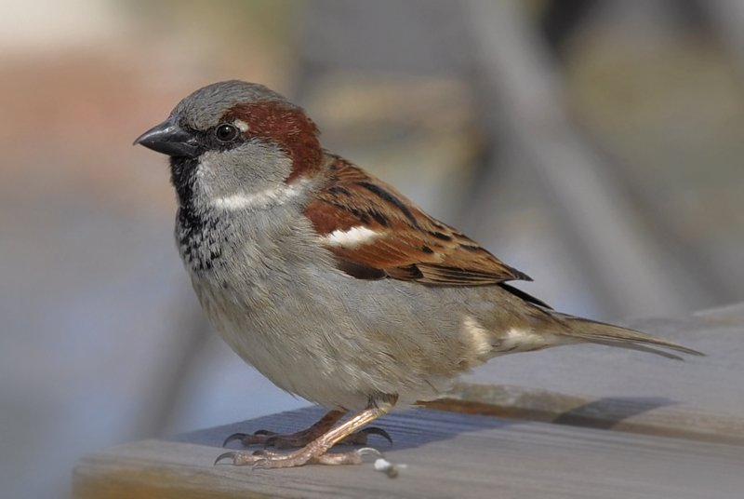
Introduction
The word sparrow (Gr. strouthion) is the name given to several different species of birds in the Bible.
They ate grain and insects and gathered in noisy flocks.
These tiny birds were such social creatures that a lone sparrow was the symbol of deep loneliness (Ps 102:7).
Sparrows would often build their untidy nests in the eaves of houses but were not driven away when they built their nests in the Temple (Ps 84:3).

Slide 5
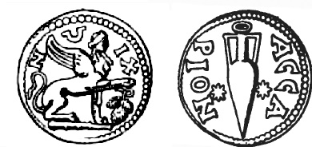
Introduction
In the days of our Lord, sparrows sold for a very low price—you could buy two of them for one copper coin (Matt 10:29).
“Sparrows were one of the cheapest items sold for poor people’s food in the marketplace, the cheapest of all birds. Two were here purchased for an assarion, a small copper coin of little value (less than a sixteenth of a denarius, hence less than an hour’s wages)
Luke 12:6 seems to indicate they were even cheaper if purchased in larger quantities.”
Craig S. Keener, The IVP Bible Background Commentary: New Testament

Slide 6

Introduction
Those who were poor and could not afford to sacrifice a sheep or a goat might bring a sparrow to the Temple (cf. Lev 14:1–7).
So insignificant were these little birds that if you bought four of them the seller would throw in one more for free (Luke 12:4–7).
It was this extra sparrow of which Jesus said, “and not one of them is forgotten before God.” Can anything be weaker or less significant than a few birds worth maybe two copper coins?
But look at God! He knows every one of the sparrows and cares for the daily fate of each one.
God’s care for His creation is so great even this extra sparrow is noted and observed by Him!

Slide 7
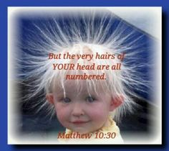
Introduction
Jesus brings out this point by telling us the hairs of our heads are all numbered.
The importance of this does not lie in the actual count, but in the fact God cares enough about His people to know the smallest detail about them. He knows things they do not know about themselves.
So, those who are of more value than many sparrows should face life without fear.
The point our Lord was making is this: if God is concerned about the tiny sparrow and notes its fate, how much greater must His concern be for man, who is immeasurably greater in value than the sparrow!

Slide 8
God’s Eye Is on Things We Deem Insignificant
Sometimes it seems that God is the only one who cares for sparrows.
Cats and hawks like to hunt and eat them, and little boys have been known to torment them. Adults complain about how they multiply and consider them pests.
Yet, Jesus said, “not one of them falls to the ground apart from your Father’s will” (Matt 10:29).
If God’s providence is so all-embracing that not even a sparrow drops from the sky apart from the will of God, cannot that same God be trusted to extend His providence over the disciples of Christ?
It is interesting Jesus chose the most common of all birds to teach a profound truth: in God’s eyes, no one is insignificant!

Slide 9
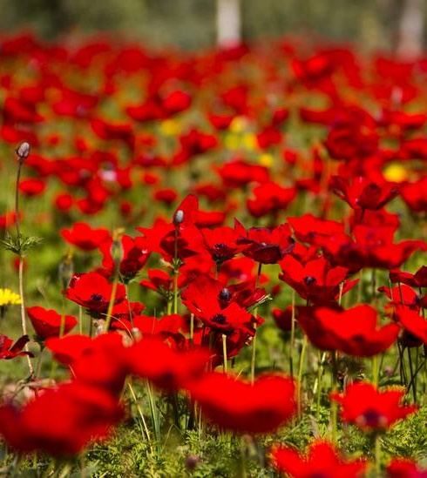
God’s Eye Is on Things We Deem Insignificant
God not only provides food for “the birds of the air,” but He also “clothes the grass of the field” (Matt 6:25–34).
The “lilies of the field” (Matt 6:28) were the scarlet poppies.
Even today, the red anemone (anemone coronaria) grows wild on the hillside above the Sea of Galilee.
They bloomed one day on the hillsides of Palestine; and yet in their brief life they were clothed with a beauty that surpassed the beauty of the robes of kings. When they died they were used for nothing better than for burning.
The point is this: the Palestinian oven was made of clay. It was like a clay box set on bricks over the fire. When it was desired to raise the temperature of it especially quickly, some handfuls of dried grasses and wild flowers were flung inside the oven and set alight.
The flowers had but one day of life; and then they were set alight to help a woman to heat an oven when she was baking in a hurry; and yet God clothes them with a beauty which is beyond man’s power to imitate.
If God gives such beauty to a short-lived flower, how much more will He care for man? Surely the generosity that is lavished upon a flower for one day will not be forgetful of man, the crown of His creation.

Slide 10

God’s Eye Is on Things We Deem Insignificant
David was impressed by God’s care for us (Ps 8:1–9).
When we look at the vast expanse of creation, we wonder how God could be concerned for people who constantly disappoint Him.
The next time you question your worth as a person, remember God considers you highly valuable.
We have great worth because we bear the stamp of the Creator.

Slide 11
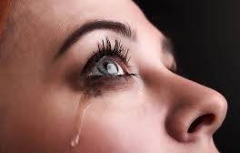
God Does Not Always Prevent Evil from Happening to Us
The fact “not one of them falls to the ground apart from your Father’s will” (Matt 10:29) means sometimes bad things can happen.
Even though God watches over the sparrows, this does not prevent them being hunted by predators.
Even though God watches over every one of us, this does not mean our lives will be free from care.

Slide 12
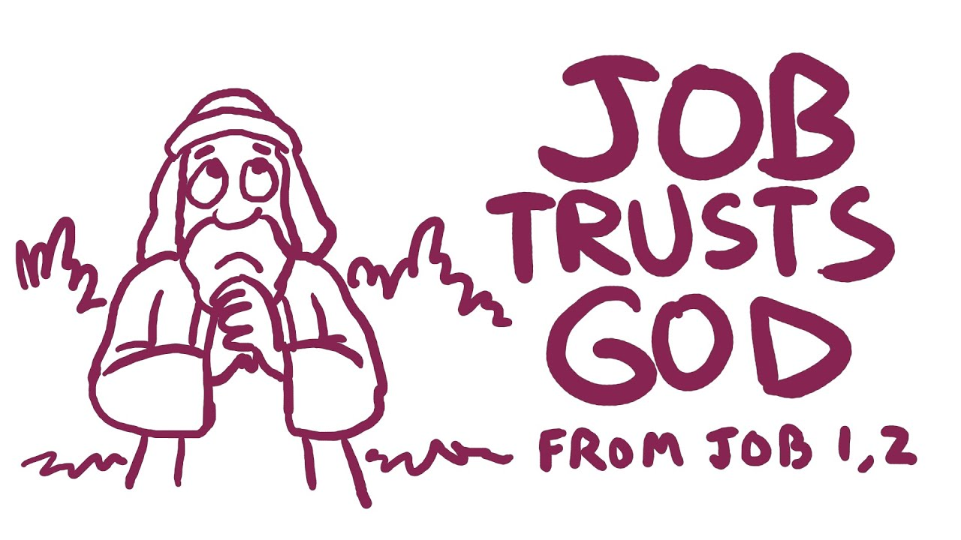
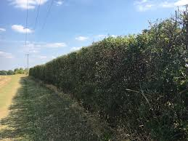
God Does Not Always Prevent Evil from Happening to Us
God had placed a “hedge” around Job (Job 1:8–11).
God allowed Satan to tempt Job (Job 1:12).
In the midst of his trials, he did not lose his trust in God (Job 1:21).
“Though He slay me, yet will I trust Him” (Job 13:15).

Slide 13
God Does Not Always Prevent Evil from Happening to Us
We can be assured with every temptation we face there will also be a way of escape (1 Cor 10:13).
"No temptation has overtaken you except such as is common to man; but God is faithful, who will not allow you to be tempted beyond what you are able, but with the temptation will also make the way of escape, that you may be able to bear it."
The temptations you will face are the common lot of all human beings.
God is not simply a spectator of the affairs of life—He is concerned and active.
But God is faithful! — these words ought to be carved in gold letters on the memory and imagination of all Christians.
Believers can count on His help. He will always make a way out. There are no special cases! When you reach the end of your rope, tie a knot and hang on!

Slide 14
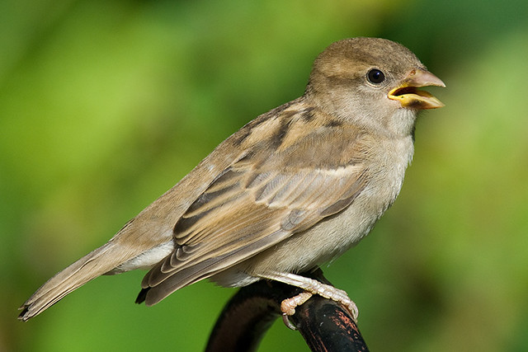
God’s Care Continues for Us
We may not hold the tiny sparrow in high esteem, but the Son of God used it to illustrate our heavenly Father’s watchful care:
“You are of more value than many sparrows” (Matt 10:31).
If God is concerned about the tiny sparrow, how much greater must His concern be for man, who is immeasurably greater in value than the sparrow!

Slide 15
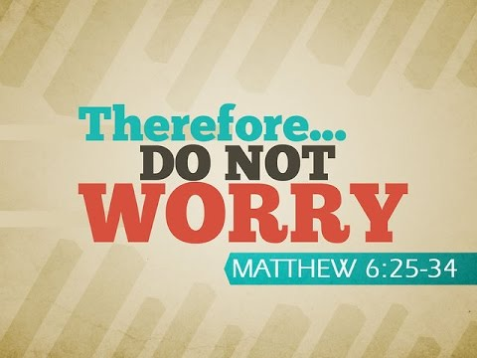
God’s Care Continues for Us
There is no place for worry in the life of a sparrow, and no attempt to pile up goods for an unforeseeable future—yet their lives go on.
The point Jesus is making is not that the birds do not work; it has been said no one works harder than the average sparrow to make a living;
The point He is making is that they do not worry.
You will never see a sparrow straining to see a future he cannot see or seeking to find security in the things he has accumulated for the future.

Slide 16

God’s Care Continues for Us
Worry is needless, useless and even injurious (Matt 6:25–32).
Worry which wears out the mind also wears out the body.
Worry affects a man’s judgment, lessens his powers of decision, and renders him progressively incapable of dealing with life.
Worry is a manifestation of our lack of faith in God (Matt 6:30).
We need to learn to be content (Phil 4:4–13).

Slide 17
God’s Care Continues for Us
In the midst of turbulent times Habakkuk said:
"Though the fig tree may not blossom, nor fruit be on the vines; though the labor of the olive may fail, and the fields yield no food; though the flock be cut off from the fold, and there be no herd in the stalls -- Yet I will rejoice in the Lord, I will joy in the God of my salvation" (Hab 3:17-18).

Slide 18
God’s Care Continues for Us
God's continued care for us should bring contentment in our lives.
"But godliness with contentment is great gain. For we brought nothing into this world, and it is certain we can carry nothing out. And having food and clothing, with these we shall be content." (1 Tim 6:6-10).

Slide 19
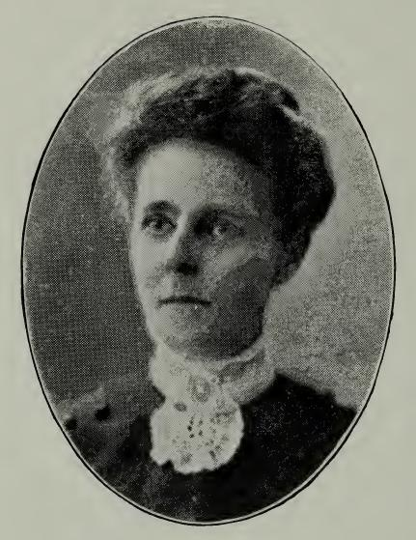
Conclusion
In 1904 a songwriter, Mrs. Civilla Martin, went to visit a bedridden friend in Elmira, New York.
Mrs. Martin asked the woman if she ever got discouraged because of her physical condition.
Her friend quickly responded: “Mrs. Martin, how can I be discouraged when my heavenly Father watches over each little sparrow and I know He loves and cares for me?”
On her journey back home, Mrs. Martin completed the writing of her new text, which has since been a source of much encouragement to many of God’s people.

Slide 20
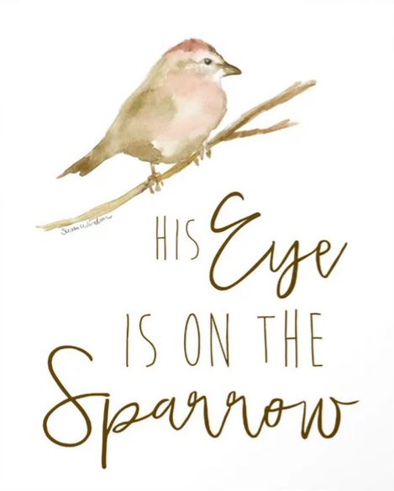
His Eye Is On The Sparrow
Why should I feel discouraged, why should the shadows come,
why should my heart be lonely and long for Heaven and home,
when Jesus is my portion? My constant Friend is He:
His eye is on the sparrow, and I know He watches me…
“Let not your heart be troubled,” His tender word I hear,
and resting on His goodness, I lose my doubts and fears;
though by the path He leadeth but one step I may see:
His eye is on the sparrow, and I know He watches me…
Whenever I am tempted, whenever clouds arise,
when songs give place to sighing, when hope within me dies,
I draw the closer to Him; from care He sets me free;
His eye is on the sparrow, and I know He watches me…
Refrain: I sing because I’m happy, I sing because I’m free, for His eye is on the sparrow, and I know He watches me.

Slide 21
Conclusion
God's care for us is immeasurable -- He allowed His only begotten Son to die in our stead (John 3:16). When we consider the "riches of His goodness, forbearance, and longsuffering" this ought to soften our heart, "knowing that the goodness of God leads you to repentance" (Rom. 2:3-4).
God's care for us will sustain us throughout life, for "we know all things work together for good to those who love God, to those who are the called according to His purpose" (Rom 8:28).
God's care for us extends beyond the grave and into that home of the soul, for those who "do His commandments" have the right to the tree of life, and "may enter in through the gates into the city" (Rev 22:14).

